Slide 1
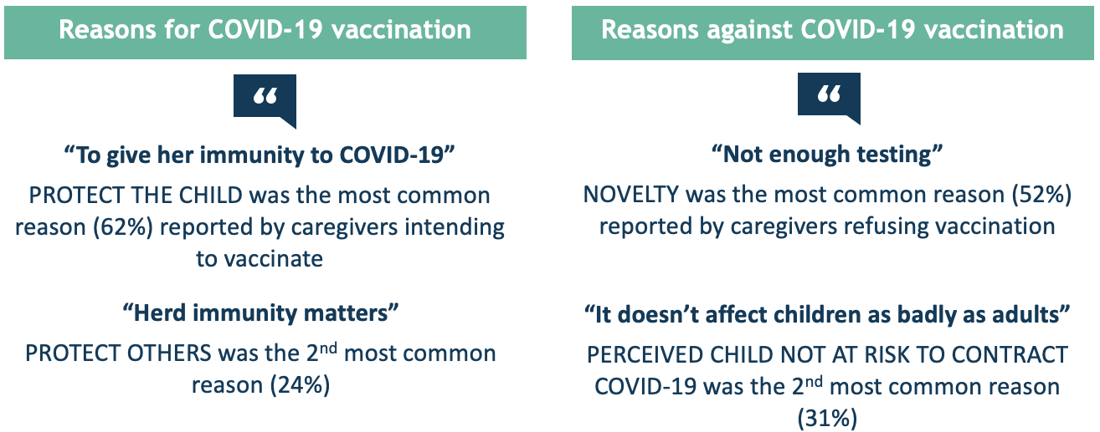
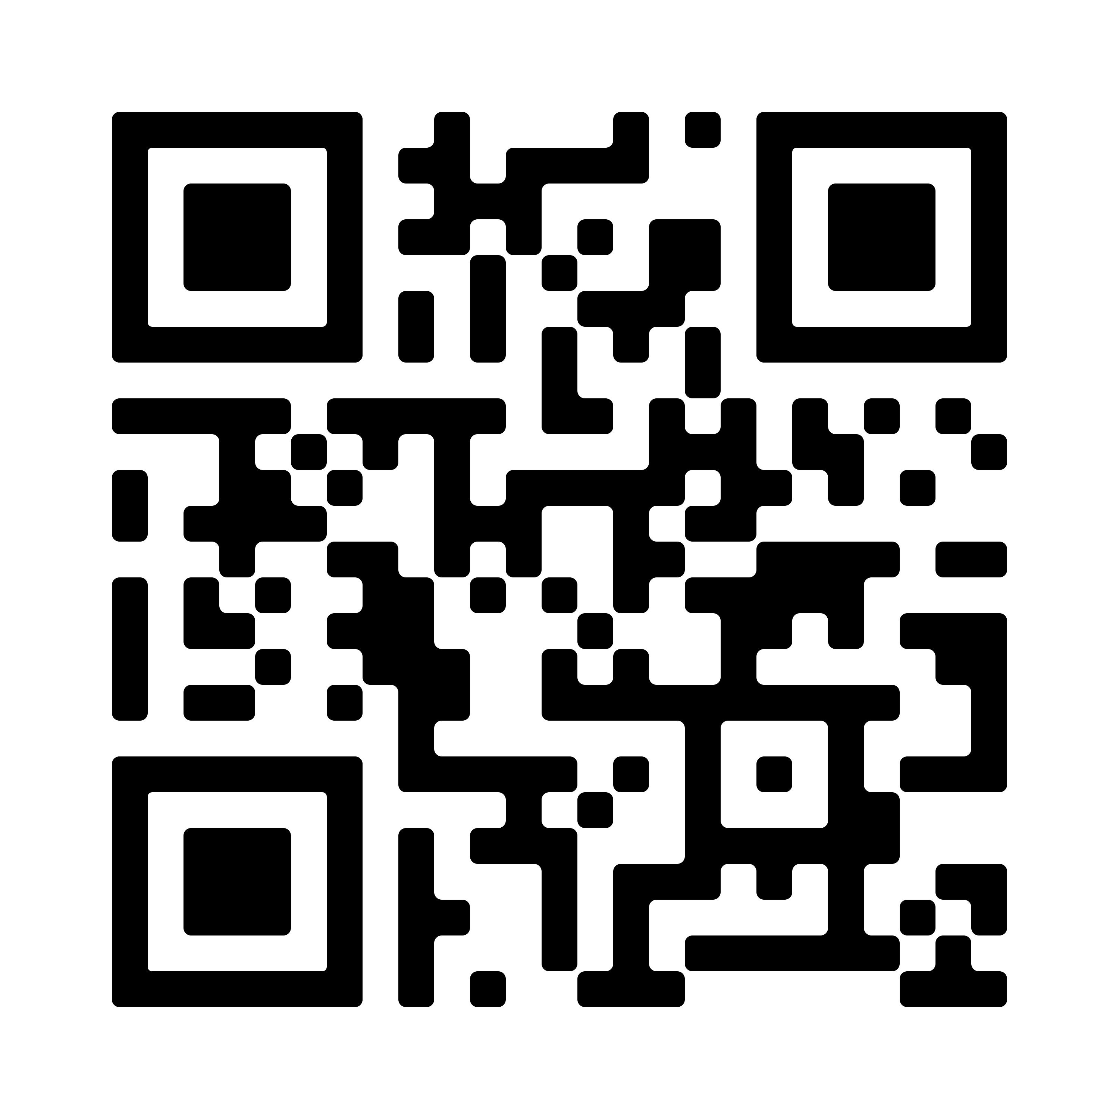
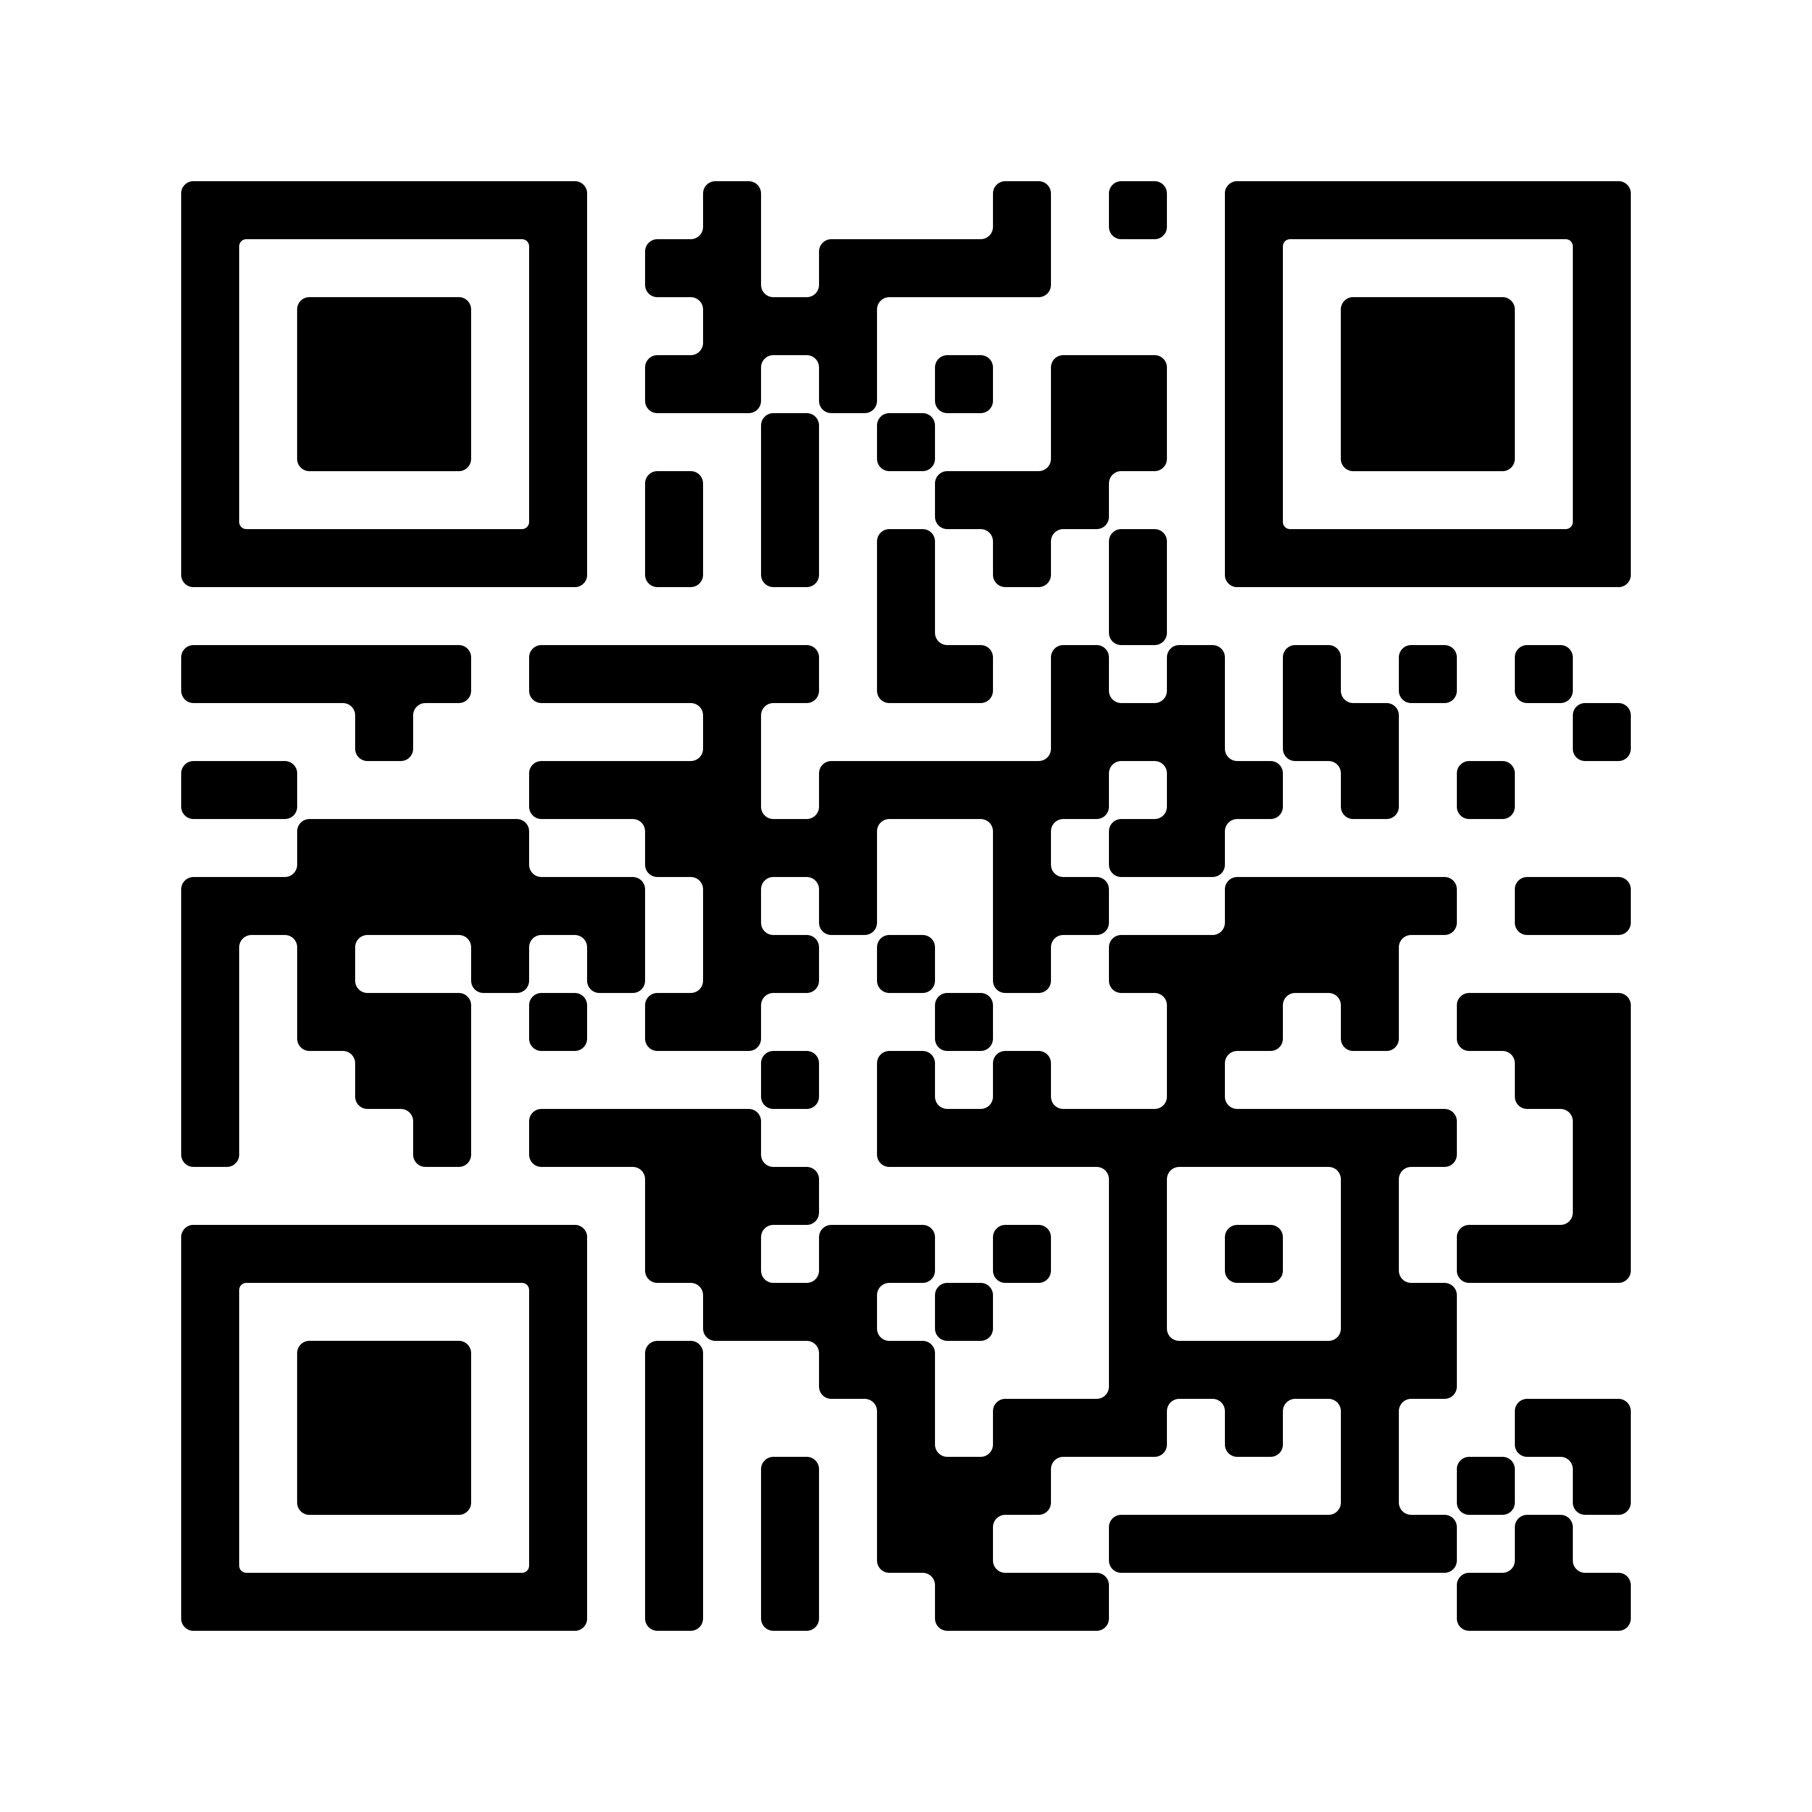
43% of caregivers are accepting of expedited vaccine testing during a pandemic, and 65% plan to vaccinate their children against COVID-19.
Non-Cognitive Predictors of Student Success: A Predictive Validity Comparison Between Domestic and International Students
Non-Cognitive Predictors of Student Success: A Predictive Validity Comparison Between Domestic and International Students
Caregivers’ willingness to accept expedited vaccine research and intent to vaccinate their children during the COVID-19 pandemic
Non-Cognitive Predictors of Student Success: A Predictive Validity Comparison Between Domestic and International Students
Tyler D. Yan, Ran D. Goldman, for the International COVID-19 Parental Attitude Study (COVIPAS) Group
GLOBAL HEALTH IMPLICATIONS
The majority of caregivers intend to vaccinate their children against COVID-19, but uptake will likely be associated with child and caregiver demographics and vaccination history.
Public health strategies need to address barriers including providing evidence about safety and efficacy, highlighting risks and consequences of infection in children, and educating caregivers on the role of vaccination.
BACKGROUND
Over 190 vaccinate candidates are in development against COVID-19.
During the pandemic, some have gained fast-track status and two vaccines already have emergency authorization
A predicted vaccine coverage of 55% to 82% of the population is needed to provide herd immunity to SARS-CoV-2
The CDC estimates that only 40% of children in the United States received the pandemic H1N1 vaccine in 2009
Table 2 Multivariate analysis of predictors associated with caregivers’ willingness to accept expedited COVID-19 vaccine research
METHODS
 | Odds ratio | OR 95% CI | P value
Child's age | 1 | (0.999 - 1) | 0.592
Survey completed by mother | 0.641 | (0.529 - 0.775) | <0.01
Survey completed by non-mother-non-father | 0.7 | (0.404 - 1.2) | 0.197
Child's vaccinations are up to date | 1.72 | (1.29 - 2.31) | <0.001
Caregiver would vaccinate their child against COVID-19 if a vaccine existed today | 1.84 | (1.54 - 2.21) | <0.001
Caregiver is worried that their child has COVID-19 | 0.999 | (0.951 - 1.05) | 0.963
Caregiver is worried that they have COVID-19 | 1.1 | (1.05 - 1.16) | <0.001
International cross-sectional survey of parents arriving with their children to the emergency department in the midst of the pandemic
17
Pediatric Emergency Departments
6
Countries (Canada, U.S., Israel, Japan, Spain, Switzerland)
7
Languages (English, French, German, Spanish, Japanese, Italian, Hebrew)
48
Survey Questions (related to demographic characteristics, information regarding the ED visit, and attitudes about COVID-19)
RESULTS
43%
Of caregivers are willing to accept less rigorous testing and faster approval of a COVID-19 vaccine
Paper 1
Table 3 Multivariate analysis of predictors associated with caregivers’ intent to vaccinate their children against COVID-19
65%
Of caregivers are planning on vaccinating their children against COVID-19, when a vaccine becomes available
 | Odds ratio | OR 95% CI | P value
Child's age | 1 | (0.999 - 1) | 0.592
Survey completed by mother | 0.641 | (0.529 - 0.775) | <0.01
Survey completed by non-mother-non-father | 0.7 | (0.404 - 1.2) | 0.197
Child's vaccinations are up to date | 1.72 | (1.29 - 2.31) | <0.001
Caregiver would vaccinate their child against COVID-19 if a vaccine existed today | 1.84 | (1.54 - 2.21) | <0.001
Caregiver is worried that their child has COVID-19 | 0.999 | (0.951 - 1.05) | 0.963
Caregiver is worried that they have COVID-19 | 1.1 | (1.05 - 1.16) | <0.001
Table 1 Reasons reported by caregivers in favour of COVID-19 vaccination for their children.
Reason to Vaccinate (n = 1005) | Example quote | Number of parents | Percent of available comments
Protect the child | “To give her immunity to COVID-19” | 492 | 62.4%
Protect others | ““Herd immunity matters” | 187 | 23.7%
General vaccine acceptance | “Vaccines work” | 109 | 13.8%
Perceived pandemic severity | “Seems more deadly of a virus” | 66 | 8.4%
High risk child or family members | “He has pre-existing lung issues” | 54 | 6.8%
Accepting, but concerns of efficacy/safety | “Actually I’d wait to see how most people reacted. So would not get right away but once I was sure it was safe” | 38 | 4.8%
Desire to return to normal life | “To get back to school” | 12 | 1.5%
No comment |  | 216
Paper 2
COVIPAS Group Information (alphabetical)
tyler.yan@alumni.ubc.ca
@tylerdavidyan @Dr_R_Goldman
Dr. Sarah Ahmed, MD, Tacoma, USA
Dr. Samina Ali, MDCM, FRCPC, Edmonton, Canada
Dr. Julie C. Brown, MD, Seattle, USA
Dr. Adrienne L. Davis, MD, MSc, Toronto, Canada
Dr. Nathalie Gaucher, MD, FRCPC, PhD, Montreal, Canada
Dr. Gualco Gianluca, MD, Ticino, Switzerland
Dr. Ran Goldman, MD, Vancouver, Canada
Dr. Mark Griffiths, MD, Atlanta, USA
Dr. Jeanine E. Hall, MD, Los Angeles, USA
Dr. Matt Hansen, MD, MCR, Portland, USA
Dr. Tomohiro Katsuta, MD, PhD, Tokyo, Japan
Dr. Christopher Kelly, MD, New York, USA
Dr. Eileen J. Klein, MD, MPH, Seattle, USA
Dr. Eran Kozer, MD, Be'er Yakov, Israel
Dr. Shashidhar-R. Marneni, MD, Dallas, USA
Dr. Ahmed Mater, MD, FRCPC, FAAP, Saskatoon, Canada
Dr. Rakesh Mistry, MD, MS, Colorado, USA
Dr. Cristina Parra, PhD, Barcelona, Spain
Dr. Naveen Poonai, MD, FRCPC, London, Canada
Dr. David Sheridan, MD, MCR, Portland, USA
Dr. Naoki Shimizu, MD, PhD, Kawasaki, Japan
Dr. Esther L. Yue, MD, Portland, USA
Notes:
Notes:
In Powerpoint, click View > Guides
Keep text within gutter guides.
Author list: Don’t split names onto two lines (e.g., “Jimmy [break] Smith”). If that happens, use a new line, unless you need the space. Bold the first names of anybody who’s presenting in person.
Intro/methods/result: Do not drop below font size 28, but if you have extra space, jack up the font size until the space is full.
Do not use color in the sidebars except in graphs/figures. It’ll pull attention from the center and slow interpretation for passersby.

