Slide 1
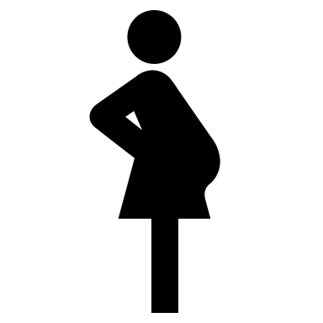
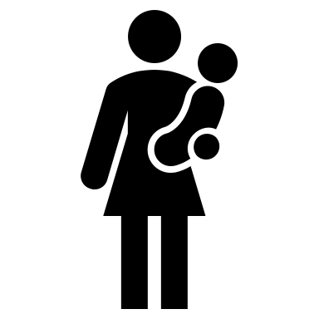
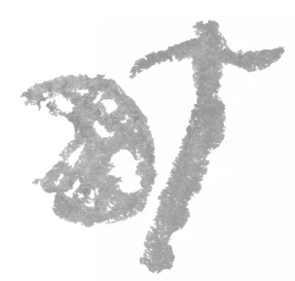
San women and children are grappling with anemia, undernutrition, and growth faltering indicators; urgent attention is warranted.
Anemia prevalence and nutrition status among San women and children in rural Botswana
Tebogo T. Leepile, Jennifer L. Black , Eduardo Jovel , and Crystal D. Karakochuk
INTRODUCTION
In Botswana, little is known about the health and nutritional status of the San People, an Indigenous minority group primarily living in Ghanzi District.
OBJECTIVE
To assess the prevalence of anemia and nutritional status of San women and young children in Ghanzi District in rural Botswana.
METHODS
Cross-sectional survey in nine randomly selected areas.
Analysis of Hemoglobin (Hb) concentration (HemoCue) and anthropometrics (weight and height measurements), n=367 San mother-child pairs.
Anemia was determined by the WHO cut-offs (children and pregnant women, Hb <110 g/L, non-pregnant women Hb <120 g/L while BMI and z-scores (WHO growth reference) were used to assess the nutritional status of women and children respectively.
RESULTS
Large households (8.5 ± 4.4 people).
Poverty (low incomes; 69% households live on <175USD/month) and lack household toilets.
Anemia Prevalence
DISCUSSION
High prevalence of undernutrition among San women and young children.
Anemia ranged widely based on Hb adjustment factors, from 6-26% in non-pregnant women, 22-30% in pregnant women and 35-63% in children.
Rates of anemia were higher in peri-urban areas compared to rural areas (women (20% vs. 11%) and children (51% vs. 40%).
Among children differences in malnutrition between the age groups were observed:
6-23 months, peri-urban-based children were the most affected compared with their counterparts in rural areas.
24-59 months, prevalence of child malnutrition higher among children in rural areas.
GLOBAL HEALTH IMPLICATIONS
To our knowledge, this is the first study to provide specific and comprehensive data on the Indigenous San People of Botswana.
These findings will elucidate future key priority areas and will inform and guide targeted nutrition and health policies.
RESEARCH PARTNERS
Hb, Anemia (n=367)
Women | All | Non-pregnant | Pregnant
Hb, g/L, mean ± SD | 137±16 | 138±15 | 122±15
Prevalence, n (%) | 48/367 (13%) | 42/344 (12%) | 6/23 (26%)
Children | All | Rural | Peri-urban
Hb, g/L, mean ± SD | 111±16 | 112±16 | 108±13
Prevalence, n (%) | 153/367 (42%) | 117/296 (40%) | 36/71 (51%)
52% of pregnant women were underweight
42% of children were anemic, 65% stunted, and 13% wasted
13% of all women were anemic and 56% smoked
Letloa Trust
contact: tebogo.leepile@ubc.ca
Values adjusted for altitude, ethnicity, and smoking
i) Women: underweight (BMI <18.5 kg/m²) ii) Children; wasting (low weight-for-length/height, WLZ/WHZ <-2 SD), stunting (low length/height-for-age, LAZ/HAZ <-2 SD)

