Slide 1
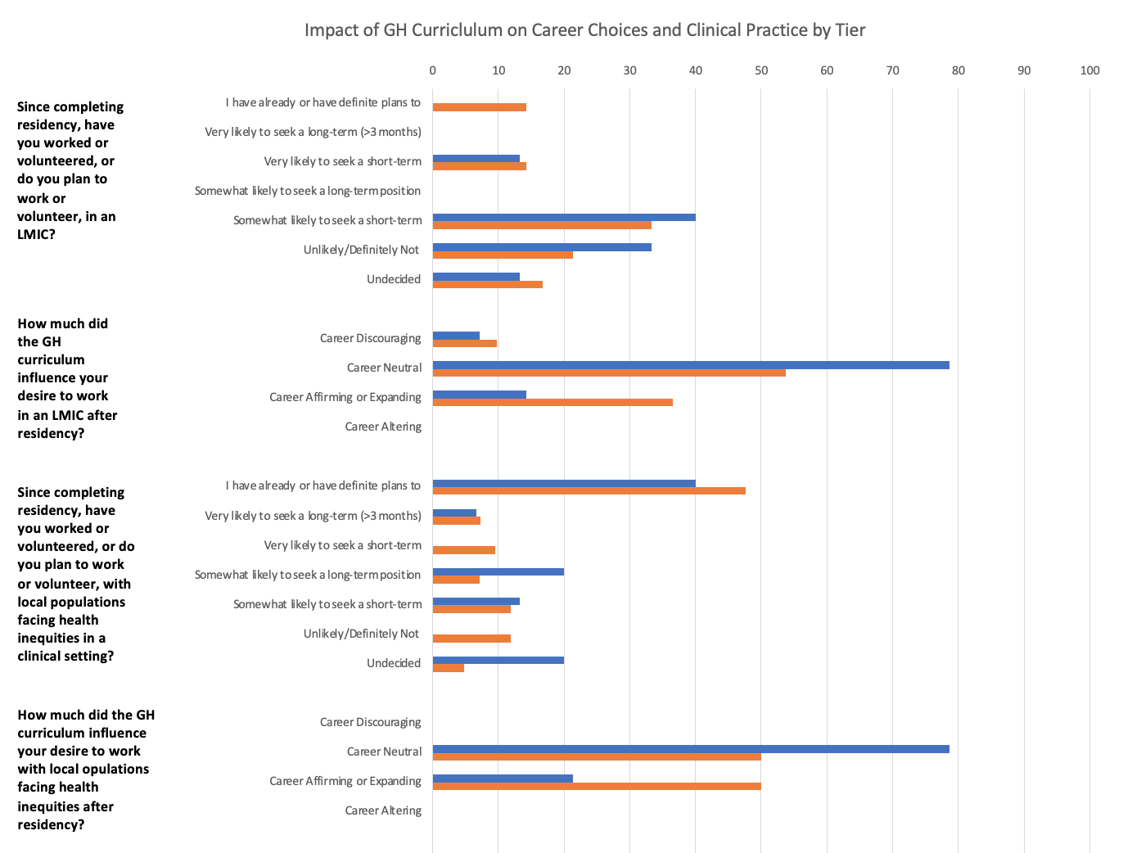

Non-Cognitive Predictors of Student Success:
A Predictive Validity Comparison Between Domestic and International Students
The Impact of a Global Health Curriculum in Residency on Pediatricians’ Clinical Practice
Non-Cognitive Predictors of Student Success:
A Predictive Validity Comparison Between Domestic and International Students
Non-Cognitive Predictors of Student Success:
A Predictive Validity Comparison Between Domestic and International Students
Suleman R¹, Stockley K², Smitten J², Sauvé, L²
1.University of British Columbia, Faculty of Medicine
2.University of British Columbia, Department of Pediatrics
HIGHER LEVELS OF PARTICIPATION IN A GH CURRICULUM DURING RESIDENCY WERE CORRELATED WITH INCREASED INTEREST IN PURSUING GH ACTIVITIES AFTER RESIDENCY
RESULTS
Motivations for participating in the program included desire to improve clinical skillset, gain exposure to novel contexts of practice, better understand social determinants of health, and give back to underserved populations
Barriers to further GH participation included personal life circumstances, professional constraints, and lack of structured opportunities.
Program graduates felt unprepared to competently address refugee and indigenous health issues, access community resources beyond tertiary care settings and pursue non-clinical GH activities after residency.
Higher participation in GH activities post-residency were also positively correlated with living in a low/middle-income country (LMIC) pre-residency, and having prior GH exposure
CONCLUSIONS
Participation in a GH curriculum during residency may promote physicians to practice in GH contexts during their career, however; we must recognize barriers to pursuing GH opportunities and areas of existing GH curricula that require strengthening.
INTRO
Global health (GH) competencies have been integrated into several residency training programs.
The Pediatric Residency Program at the University of British Columbia (UBC) has developed a robust GH education framework that is delivered in a tiered format.
This study aimed to examine the impacts of the GH curriculum on graduates of the UBC Pediatric Residency Program.
METHODS
Pediatricians that had graduated from the program between 2009-2019 were recruited via email and social networking. to participate in an anonymous online survey.
Descriptive analyses were performed on the categorical variables. Thematic analyses were conducted with two reviewers initially, followed by two additional reviewers for qualitative data.
Tier 1: Participated in mandatory GH curriculum only
Tier 2/3: Participated in additional GH opportunities during residency
74 eligible participants were identified out of 119 graduates that were contacted
Notes:
Notes:
In Powerpoint, click View > Guides
Keep text within gutter guides.
Author list: Don’t split names onto two lines (e.g., “Jimmy [break] Smith”). If that happens, use a new line, unless you need the space. Bold the first names of anybody who’s presenting in person.
Intro/methods/result: Do not drop below font size 28, but if you have extra space, jack up the font size until the space is full.
Do not use color in the sidebars except in graphs/figures. It’ll pull attention from the center and slow interpretation for passersby.

