Slide 1
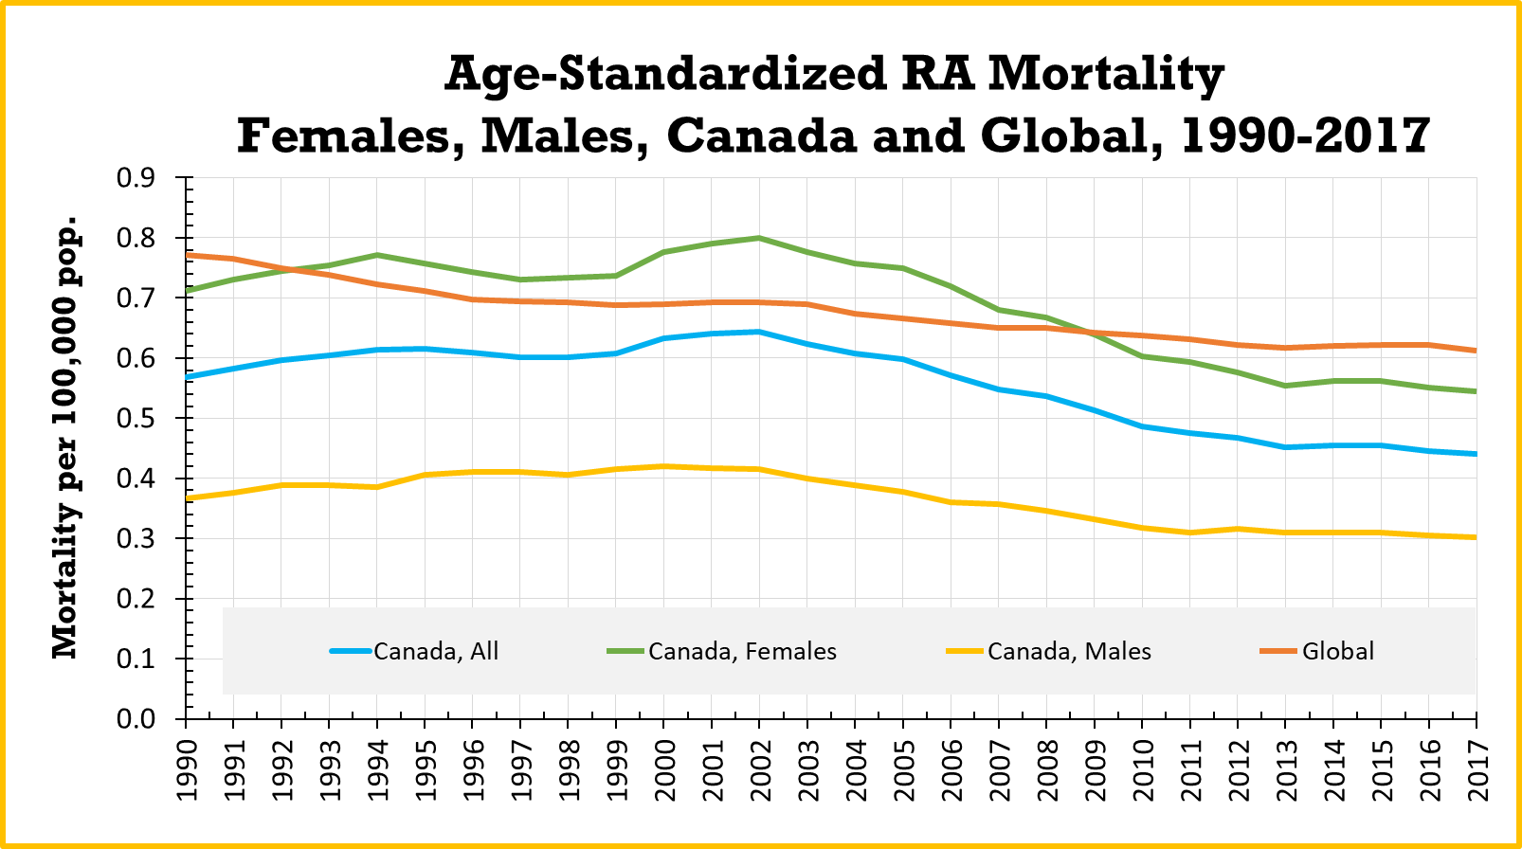
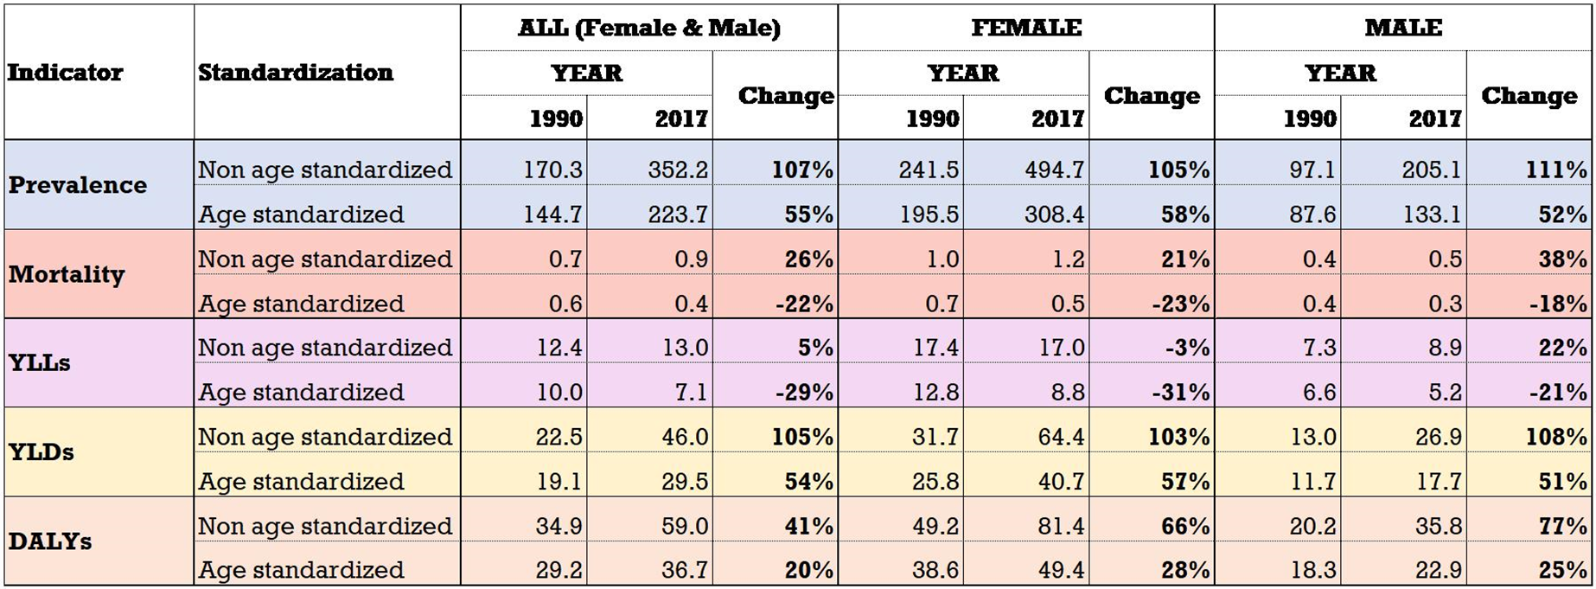
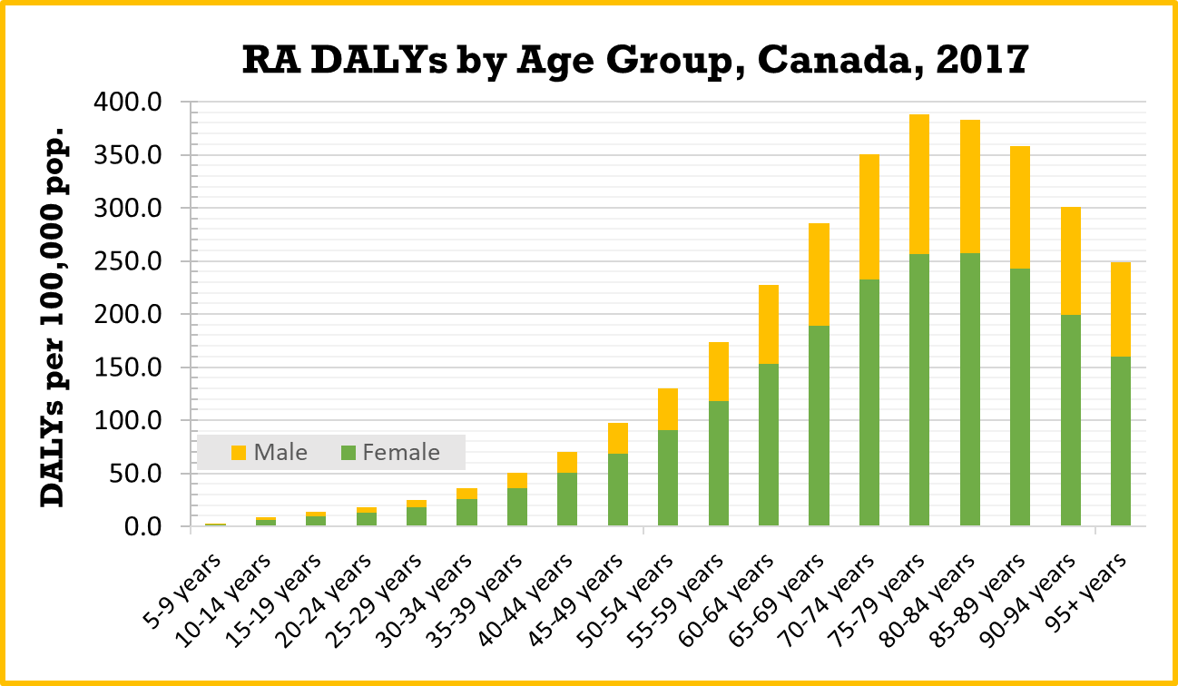
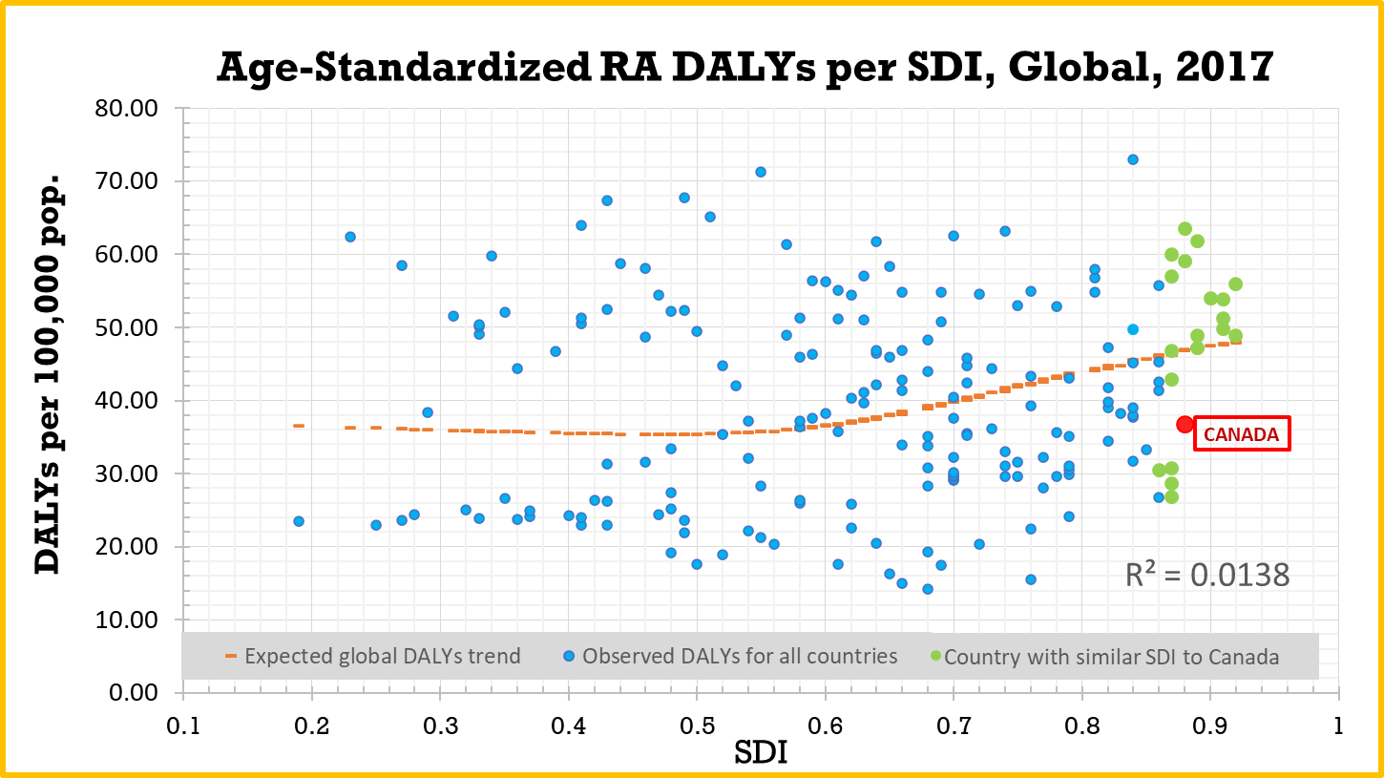
Over time, mortality from RA in Canada decreased, but disability and overall burden increased.
Non-Cognitive Predictors of Student Success: A Predictive Validity Comparison Between Domestic and International Students
Non-Cognitive Predictors of Student Success: A Predictive Validity Comparison Between Domestic and International Students
Non-Cognitive Predictors of Student Success: A Predictive Validity Comparison Between Domestic and International Students
National Burden of Rheumatoid Arthritis in Canada 1990-2017: Findings from the Global Burden of Disease Study 2017
Nejat Hassen, Diane Lacaille, Alice Xu,
Sophia Sidi, Amani Alandejani,
Marjan Mansourian, Nizal Sarrafzadegan,
Jacek Kopec
GLOBAL HEALTH IMPLICATIONS
Having a comprehensive overview of RA disease burden in Canada allows us to draw conclusions about what is working well in the Canadian health care system’s approach to mitigating RA burden in the country. This information can be shared with other counties with worse RA burden to suggest successful treatment strategies. This will ultimately help reduce the overall global RA disease burden.
INTRO
According to the Global Burden of Disease (GBD) Study 2017, over 120,000 individuals had rheumatoid arthritis (RA) in Canada, yet there is no study that evaluates the combined effect of RA on the longevity and quality of life. We aim to (1) describe burden of RA and trends over time from 1990-2017 using GBD data, (2) describe age and sex differences, and (3) compare RA disease burden in Canada to other countries.
METHODS
Disease burden indicators included prevalence, mortality, years of life lost (YLLs), years lived with disability (YLDs), and disability adjusted life years (DALYs).
GBD estimated mortality and prevalence rates based on published literature, survey data, patients records, health insurance claims, and administrative health data.
DALYs for RA in Canada were compared to DALYs of countries with similar sociodemographic index values (SDI).
Data were analyzed by DisMod-MR 2.1, a Bayesian meta-regression tool.
RESULTS
Mortality from RA decreased, but population disability and overall burden increased.
Disease burden was higher in females and older age groups.
Canada fares better than other countries regarding national RA burden.
DISCUSSION
RA is a major public health challenge for Canada, but it is handling RA relatively well and should continue to follow current treatment strategies. However, implementing female-specific RA management strategies would help reduce the national RA disease burden.
nhassen@arthritisresearch.ca
Notes:
Notes:
In Powerpoint, click View > Guides
Keep text within gutter guides.
Author list: Don’t split names onto two lines (e.g., “Jimmy [break] Smith”). If that happens, use a new line, unless you need the space. Bold the first names of anybody who’s presenting in person.
Intro/methods/result: Do not drop below font size 28, but if you have extra space, jack up the font size until the space is full.
Do not use color in the sidebars except in graphs/figures. It’ll pull attention from the center and slow interpretation for passersby.

