Slide 1
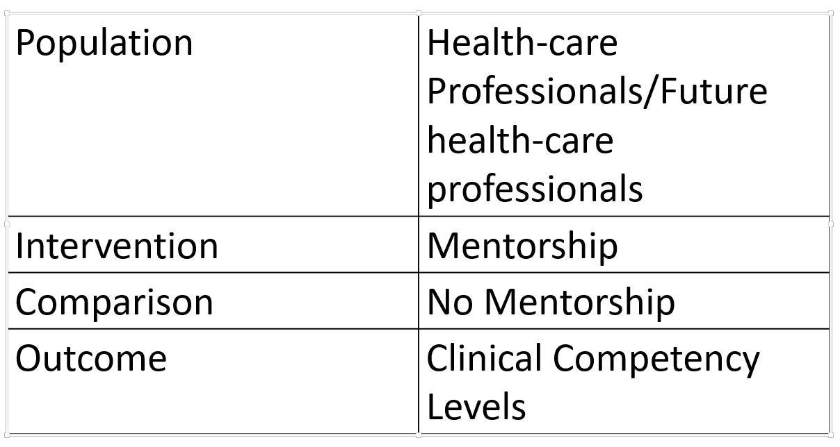
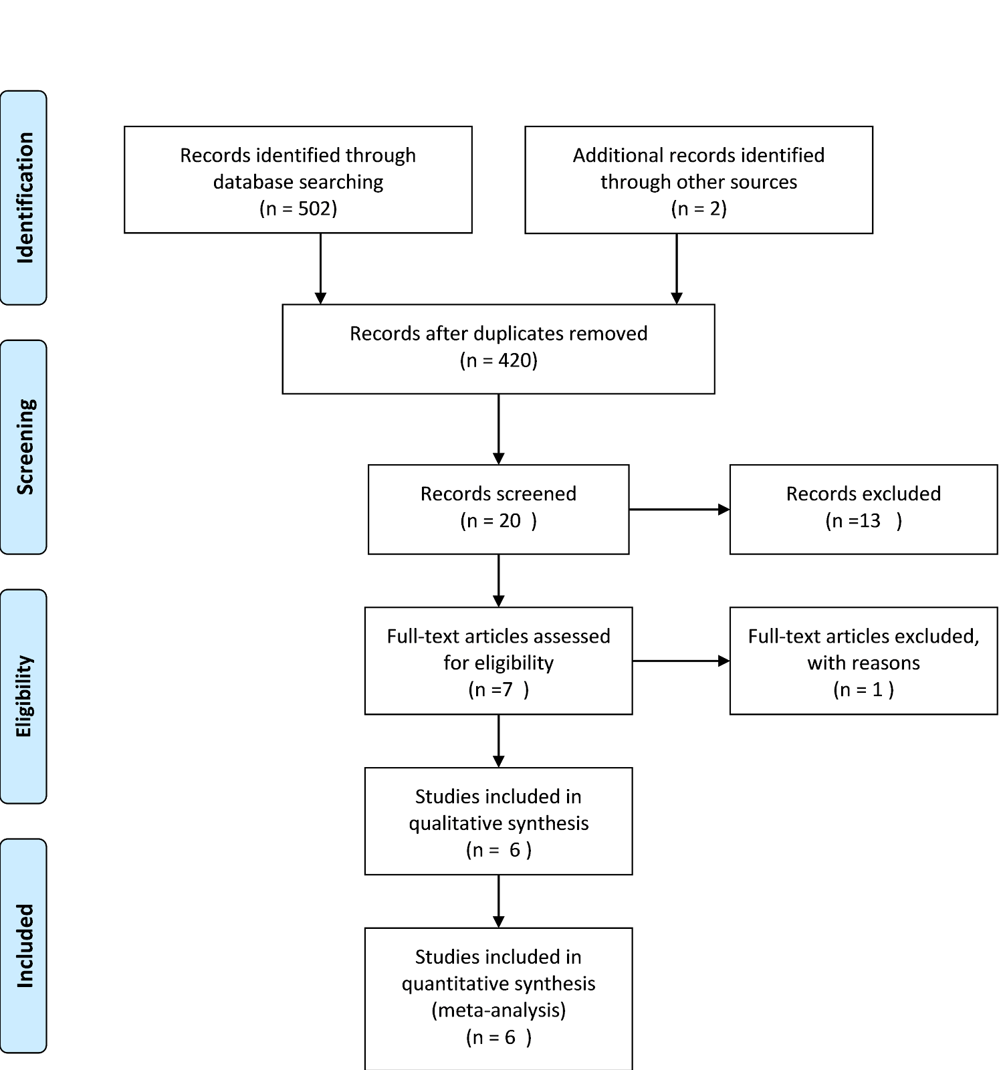
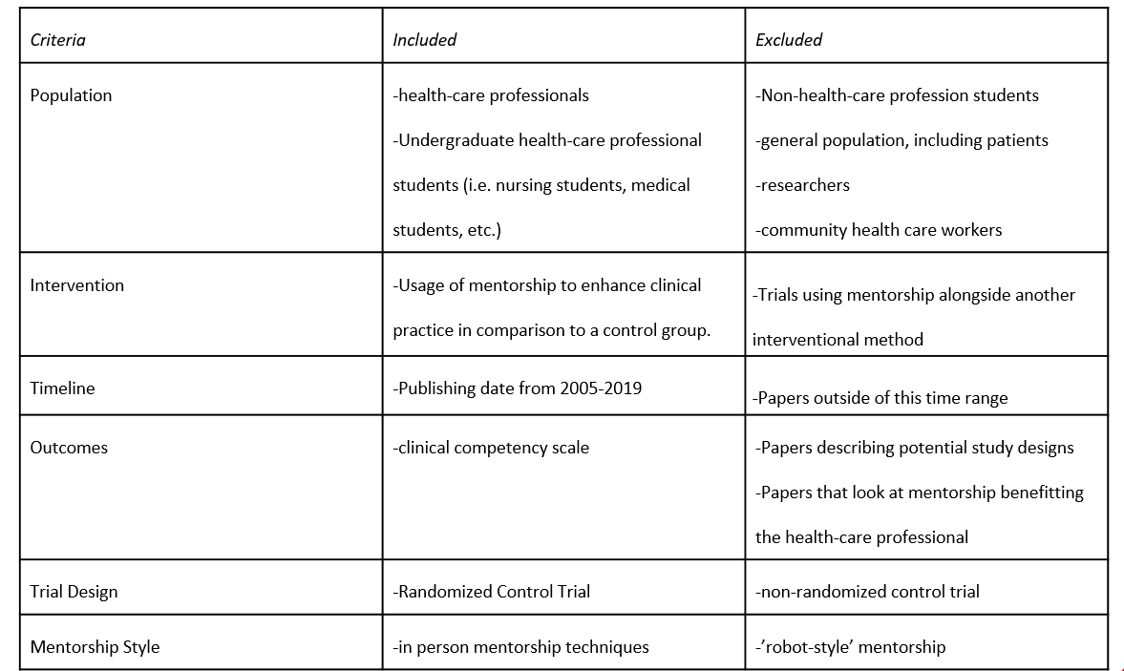
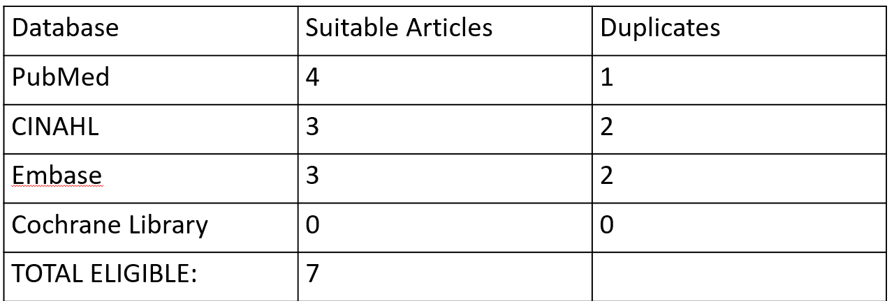
Mentorship improves clinical competency skills of healthcare workers and students.
Non-Cognitive Predictors of Student Success: A Predictive Validity Comparison Between Domestic and International Students
Non-Cognitive Predictors of Student Success: A Predictive Validity Comparison Between Domestic and International Students
Advancing Professional Healthcare by the Use of Mentorship
Non-Cognitive Predictors of Student Success: A Predictive Validity Comparison Between Domestic and International Students
Harleen Jhinger, Bridget Murray, Comfort Chima
Royal College of Surgeons in Ireland University of Medicine and Health Sciences
GLOBAL HEALTH IMPLICATIONS:
Integrating mentorship as a core part of healthcare training can change health systems.
PICO
Inclusion and Exclusion Criteria
Duplication Breakdown
References
Moher D, Liberati A, Tetzlaff J, Altman DG, The PRISMA Group (2009). Preferred Reporting Items for Systematic Reviews and Meta- Analyses: The PRISMA Statement. PLoS Med 6(7): e1000097. doi:10.1371/journal.pmed1000097
INTRO
This systematic review searched the literature for randomized control trials looking at the effects of mentorship on clinical competency skills of healthcare workers.
METHODS
Search words were identified and reviewed in four different databases.
420 original results were applied against an inclusion and exclusion criteria, and underwent quality appraisal.
Studies accepted into systematic review were evaluated for data.
RESULTS
Study
DISCUSSION
Some challenges in implementing mentorship on a widespread scale is that each healthcare system has unique challenges. For one, there may be a lack of trained healthcare professionals available to spend the time needed. There may be resource deficiencies and a lack of funding available.
harleenjhinger@rcsi.com
Notes:
Notes:
In Powerpoint, click View > Guides
Keep text within gutter guides.
Author list: Don’t split names onto two lines (e.g., “Jimmy [break] Smith”). If that happens, use a new line, unless you need the space. Bold the first names of anybody who’s presenting in person.
Intro/methods/result: Do not drop below font size 28, but if you have extra space, jack up the font size until the space is full.
Do not use color in the sidebars except in graphs/figures. It’ll pull attention from the center and slow interpretation for passersby.

