Slide 1
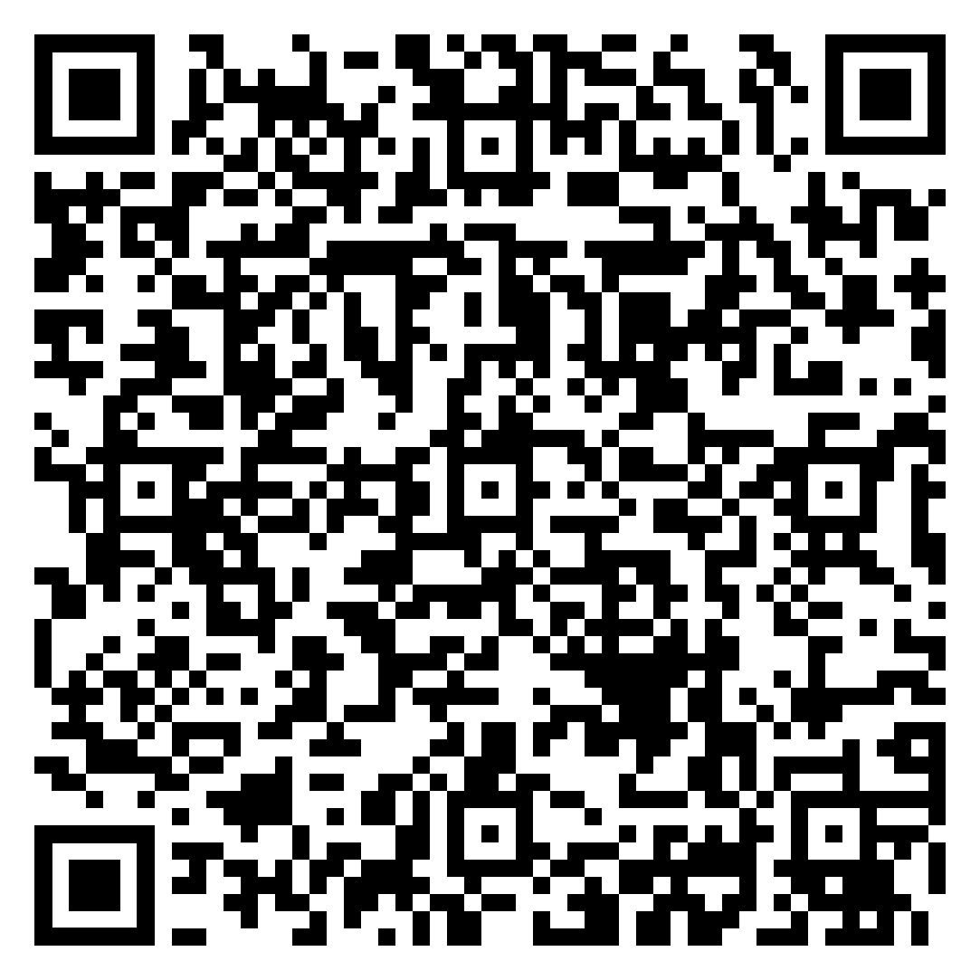
Education level and income were the most important predictors of knowledge and perceptions about health in pregnancy.
Non-Cognitive Predictors of Student Success: A Predictive Validity Comparison Between Domestic and International Students
Non-Cognitive Predictors of Student Success: A Predictive Validity Comparison Between Domestic and International Students
Factors Impacting Knowledge, Perceptions, and Preferred Resources Among Pregnant Women in Siaya County, Kenya
GLOBAL HEALTH IMPLICATIONS:
Improvements in antenatal care attendance alone will likely be insufficient to improve maternal mortality.
Social determinants of health should be addressed in efforts to improve health behaviors of expecting mothers.
Emily Spiera, Unwana Abasi, Chemuttaai Langat, Molly Guy, Debora Rogo, Maryanne Nyamogo, Khama Rogo, Tanya Rogo
INTRO
Kenya’s maternal mortality rate is 342 per 100,000, 1.6 times greater than the global rate.
Knowledge and perceptions are important determinants of health behaviors.
This study assessed factors influencing knowledge and perceptions of health in pregnancy and preferences for information resources.
METHODS
A survey was administered to 41 women in rural Kenya enrolled in a community-based, technology-enhanced model of antenatal care.
Closed- and open-ended questions were asked.
Knowledge of health and hypertension during pregnancy were evaluated using summative scores.
Thematic analysis, Spearman correlations, and Kruskal-Wallis tests were performed to assess associations.
RESULTS
Education level, individual income, and preferred information resources were correlated with knowledge scores. (Table 1 and Table 3)
Perceptions of health varied with household income and knowledge. (Table 2)
Prior antenatal care attendance was not significantly associated with knowledge scores or perceptions.
Nearly every woman ranked healthcare professionals as the most preferred information resource.
Education, individual income, household income, and prior antenatal care affected preferences of other lower ranked information resources. (Table 3)
CONCLUSIONS
Socioeconomic differences in knowledge, perceptions, and preferences for information resources persist even when women attend antenatal care.
Efforts to improve maternal mortality should consider socioeconomic status and quality of counseling in antenatal care.
Figure 1. Conceptual Model
Resources
Demographics
Knowledge
Education level
Household Income
Individual Income
Health Behaviors
Perceptions
Health Outcomes
Experiences
Prior ANC Visits
Prior Pregnancies
*Gray arrows not assessed in this study
Table 1. Factors Associated with HIP^{A} and HDP^{B} Knowledge Scores
 | HIP^{A} Score | p-value | HDP^{B} Score | p-value
Education Level | 0.440 | 0.0040* | 0.383 | 0.0136*
Household Income | 0.270 | 0.0882 | 0.048 | 0.7680
Individual Income | 0.469 | 0.0020* | 0.196 | 0.2190
# Prior Pregnancies | -0.017 | 0.9188 | -0.229 | 0.1612
# Prior ANC^{C} Visits | -0.064 | 0.7173 | -0.215 | 0.2139
HDP^{B} Score | 0.329 | 0.0360* | - | -
Table 2. Factors Associated with Perceptions of Health in Pregnancy
 | p value
Education | 0.2134
Household Income | 0.0462*
Individual Income | 0.0935
# Prior Pregnancies | 0.6425
# ANC^{C} Visits Prior to Current Pregnancy | 0.5808
HIP^{A} Score | 0.0259*
Take a picture to download the full abstract and for more information!
Table 3. Factors Associated with Preferences for Less Preferred Resources
 | Maga-zine | p-value | TV/ Radio | p-value | Inter-net | p-value | FF^{D} | p-value
Education Level | -0.189 | 0.271 | 0.218 | 0.195 | -0.447 | 0.006* | 0.483 | 0.002*
Household Income | -0.065 | 0.705 | -0.142 | 0.401 | -0.485 | 0.003* | 0.478 | 0.002*
Individual Income | -0.148 | 0.389 | 0.111 | 0.514 | -0.474 | 0.004* | 0.463 | 0.003*
# Prior Pregnancies | 0.163 | 0.356 | -0.331 | 0.052 | -0.062 | 0.770 | 0.199 | 0.238
# Prior ANC^{C} Visits | 0.119 | 0.524 | -0.380 | 0.032* | -0.199 | 0.284 | 0.302 | 0. 088
HIP^{A} Score | -0.037 | 0.833 | 0.2709 | 0.105 | -0.300 | 0.075 | 0.299 | 0.064
HDP^{B} Score | -0.151 | 0.380 | 0.495 | 0.002* | -0.379 | 0.023* | 0.082 | 0.621
@IcahnMountSinai @SagamHospital
emily.spiera@icahn.mssm.edu
^{A}Knowledge of Health in Pregnancy Score; ^{B}Knowledge of Hypertension during Pregnancy; ^{C}Antenatal Care; ^{D}Friends/Family

