Slide 1
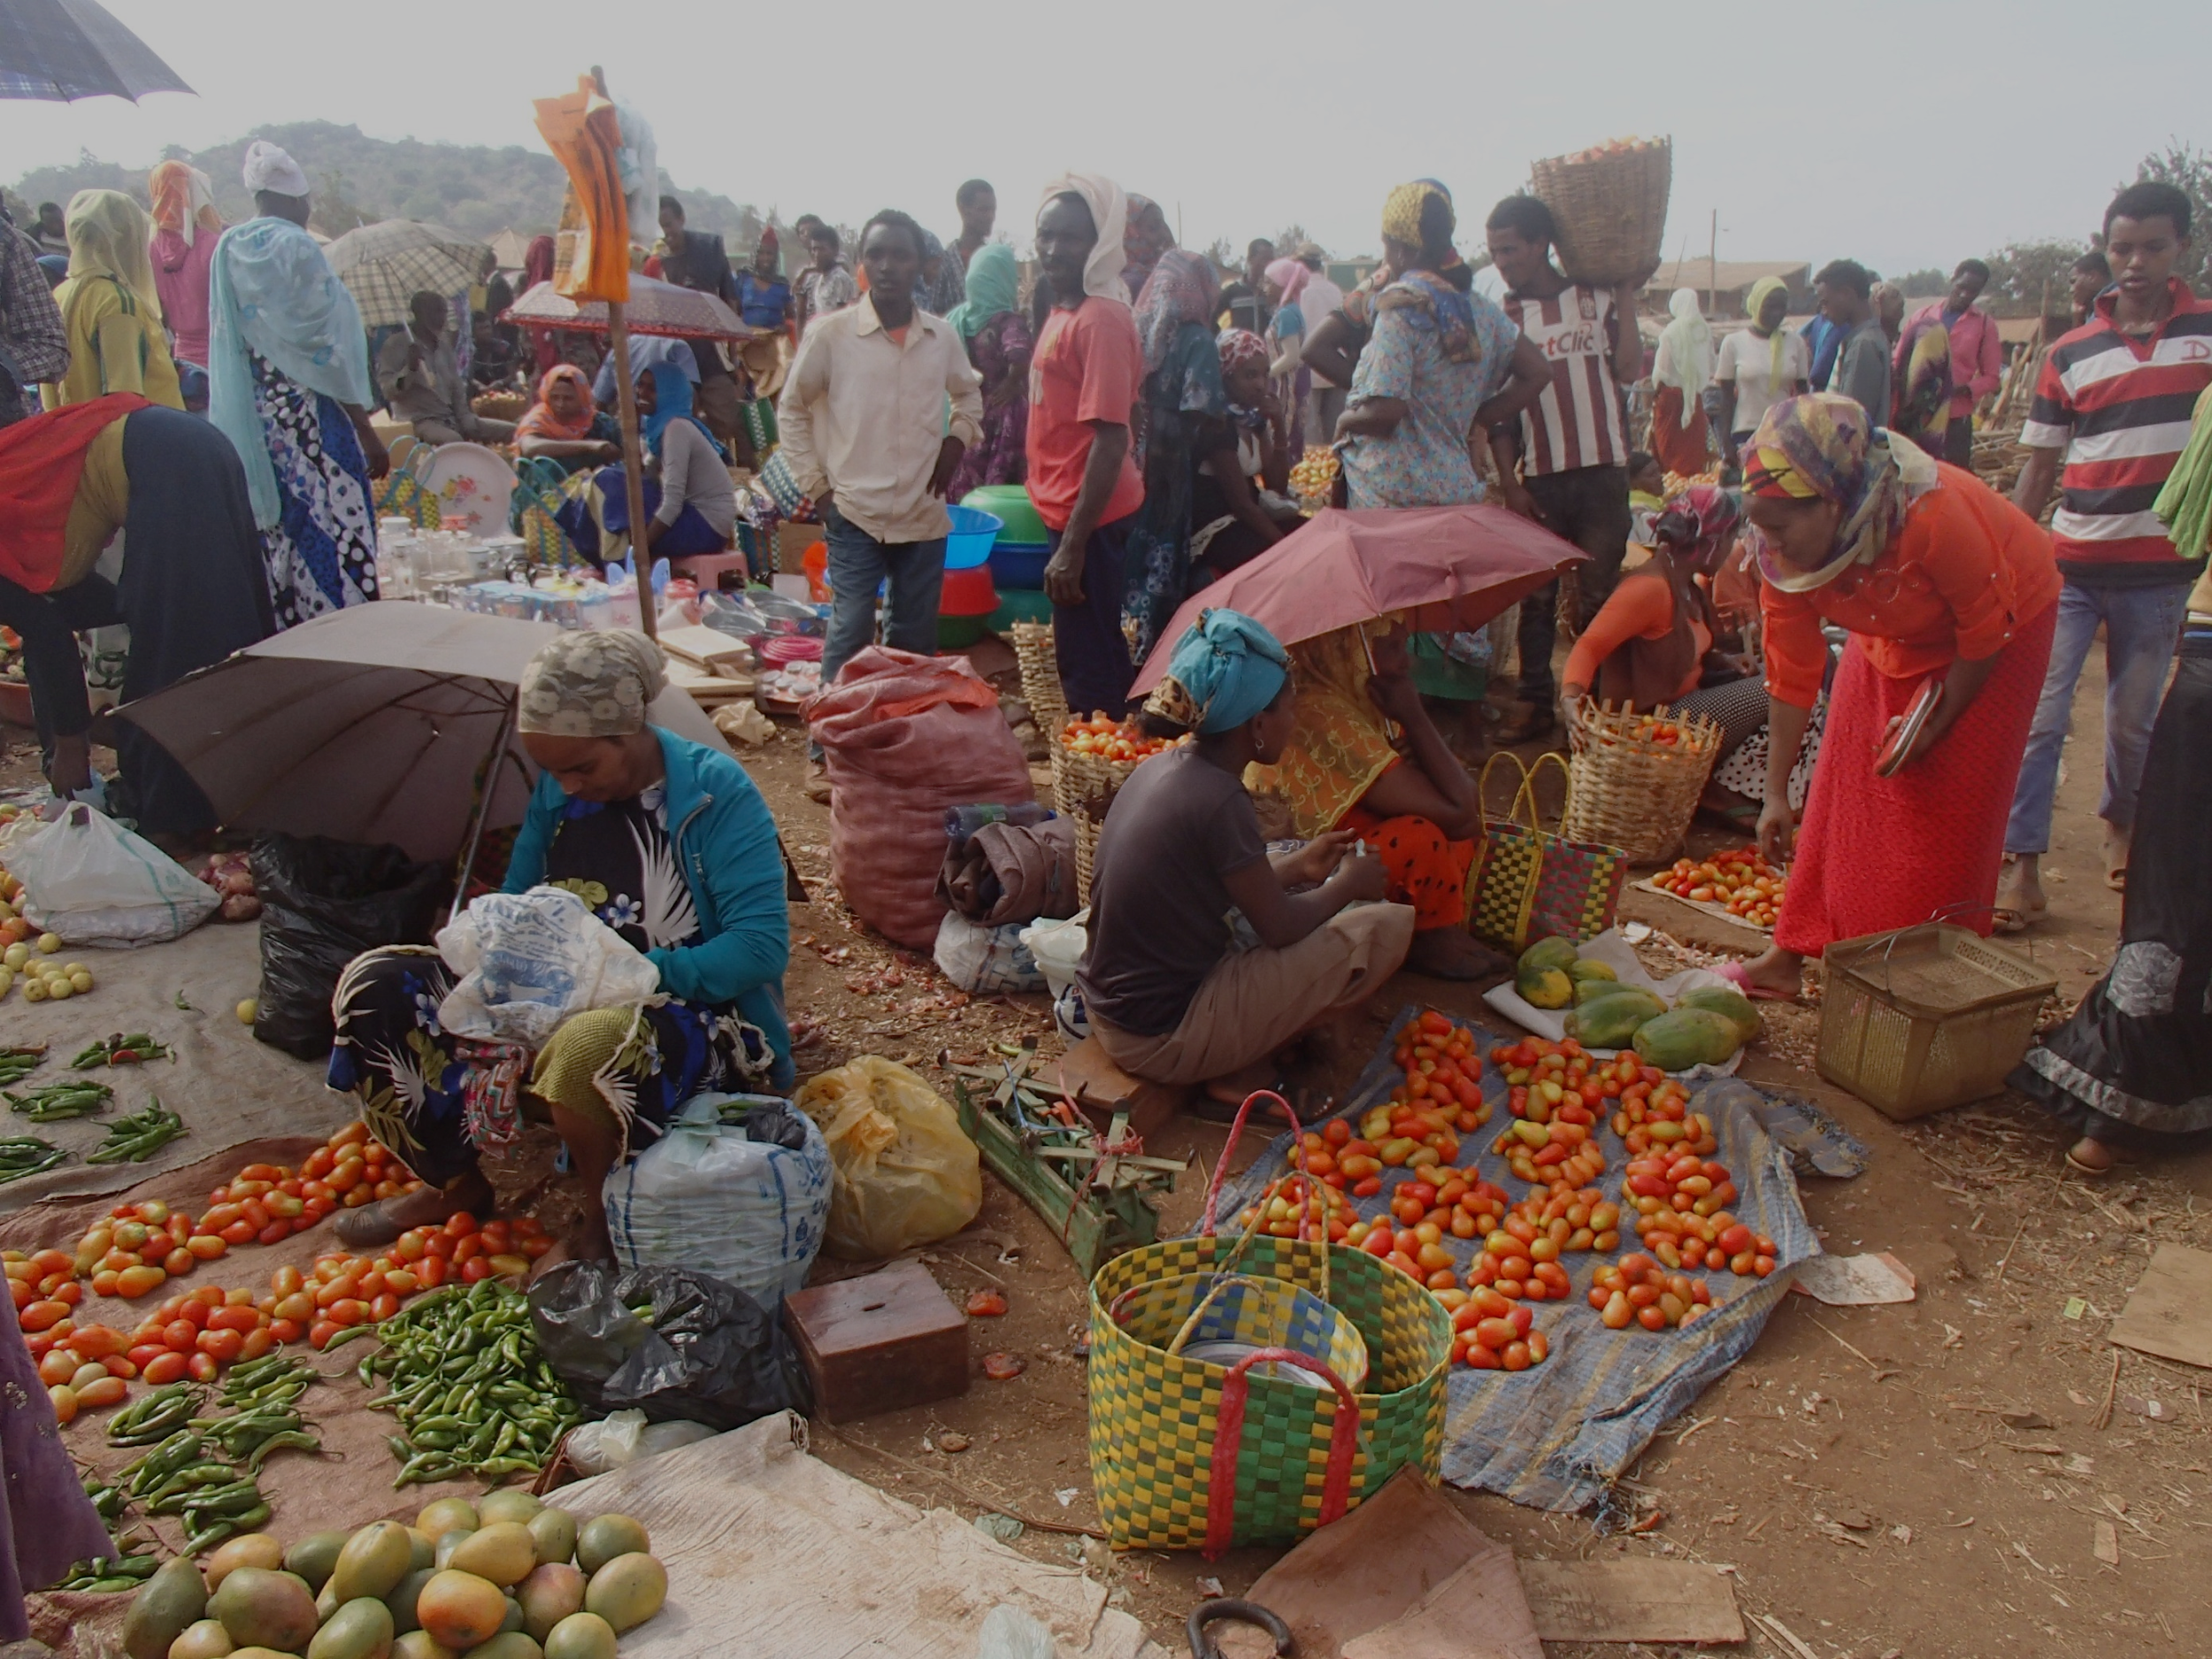
Among pregnant women in LMICs, adequate consumption of vegetables and fruits may lower the odds of developing pre-eclampsia by 62% and 58%, respectively.
Non-Cognitive Predictors of Student Success: A Predictive Validity Comparison Between Domestic and International Students
Non-Cognitive Predictors of Student Success: A Predictive Validity Comparison Between Domestic and International Students
Non-Cognitive Predictors of Student Success: A Predictive Validity Comparison Between Domestic and International Students
Maternal dietary patterns and pregnancy hypertension in low- and middle-income countries: a systematic review and meta-analysis
Mai-Lei Woo Kinshella, Shazmeen Omar, Kerri Scherbinsky, Marianne Vidler, Laura Magee, Peter von Dadelszen, Sophie E. Moore, Rajavel Elango
GLOBAL HEALTH IMPLICATIONS:
There may be a greater magnitude of effect among pregnant women in LMICs. Previous research in high-income countries (HICs) has shown that healthy maternal diets may lower the odds of developing pre-eclampsia by 13-28%.
The beneficial effects of fruits and vegetables may be further enhanced in settings with high rates of maternal malnutrition, although other socio-demographic factors may contribute.
INTRO
Healthy maternal diets may lower the odds of developing pre-eclampsia (PE), a direct and second leading cause of maternal death, globally. However, there is a research gap in low- and middle-income countries (LMICs) that bear disproportionate burdens of these deaths.
The objectives of this systematic review were to: (i) evaluate the association between dietary patterns in pregnancy and hypertensive disorders, including pre-eclampsia for pregnant and postpartum women in LMICs, and (ii) compile barriers and facilitators to an adequate maternal diet.
METHODS
A systematic search was performed on 6 academic databases, the WHO Regional Databases, two trial registries, Google Scholar and references lists.
Included in the analysis were primary research studies of dietary patterns during pregnancy, with pregnancy hypertension outcome(s), and conducted in LMICs.
Included studies were assessed using ROBINS-I risk of bias.
The protocol was registered on Prospero CRD42018116082.
RESULTS
Thirteen studies were included 🡪 five studies included in a meta-analysis.
Adequate (vs. no or low) consumption of vegetables OR 0.38, 95% CI: 0.18-0.80, I2 85%, p=0.01)
Adequate (vs. no or low) consumption of fruit (OR 0.42, 95% CI: 0.24-0.71, I2 79%, p=0.008)
Maggie.kinshella@cw.bc.ca @MaggieWooK
Notes:
Notes:
In Powerpoint, click View > Guides
Keep text within gutter guides.
Author list: Don’t split names onto two lines (e.g., “Jimmy [break] Smith”). If that happens, use a new line, unless you need the space. Bold the first names of anybody who’s presenting in person.
Intro/methods/result: Do not drop below font size 28, but if you have extra space, jack up the font size until the space is full.
Do not use color in the sidebars except in graphs/figures. It’ll pull attention from the center and slow interpretation for passersby.

