Slide 1
Metabolomics: Preanalytical Variables
A work in progress

Slide 2
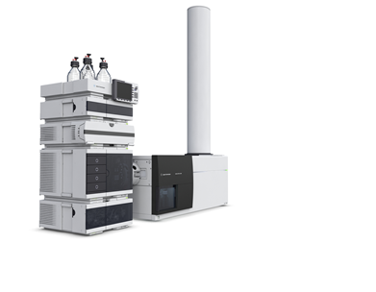
QTOF Metabolomics
Tandem MS
Most clinical testing is targeted
Select by intact mass > fragment > confirm ID by product(s)
Limited # of analytes at any one time (duty cycle)
QTOF MS
Time-of-flight (TOF) has mass accuracy to 2ppm
Compound identified by the accurate intact mass (to 4 decimals)
No need to fragment*, massive increase in # of analytes detected.

Slide 3
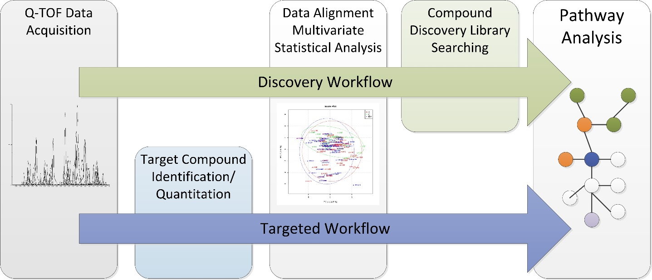
Targeted and Discovery Metabolomics
Targeted
138 compounds of interest for inborn errors of metabolism
Identify by retention time and exact mass
Quantitate against standards
Discovery
Extract “features” from QTOF data
Normalize abundance and align retention times
Select informative features (relative comparisons)
Identify compounds based on exact mass
Uncertainty (Quality scores):
Features between samples (RT and mass)
Intensity between conditions (normalization)
Compound identification*

Slide 4
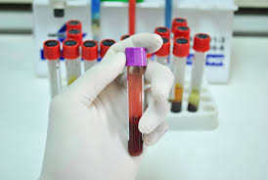
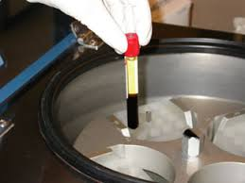
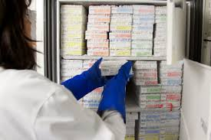
Study Design
Sample handling affects are significant
False negatives and false positives from process variability
Plasma from a single individual same day
Baseline (Fasted, processed and into -80C within 20 min.)
Delayed Processing (Whole blood at RT 1hr)
Delayed Freezing (Plasma 4C for 8 hr)
Standard Freezing (-30C for 14 days)
Post-prandial (4 hrs after meal)
Freeze/Thaw (baseline thawed and refrozen)
3 replicates injected 3 times (9 runs per condition)
Reversed Phase and HILIC
Positive ion and negative ion mass spectral acquisition
216 individual runs

Slide 5
Targeted Analysis
Standard mix of high calibrators from 4 BGL assays
Amino acids, acylcarnitines, organic acids, purines/pyrimidines, creatine
138 compounds in an aqueous matrix
Results
76 compound tentatively identified
46 by HILIC Chromatography (+/-)
35 by Reversed Phase (+/-)
Issues
Coelution of isobars (chromatography)
Multiple peaks for same compound (in source fragmentation)
Haven’t tried a biological matrix yet
10 min. run time

Slide 6
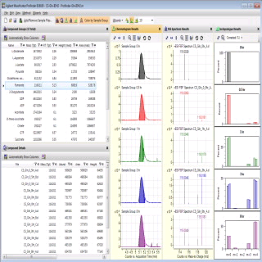
Discovery Metabolomics
Q-TOF Data acquisition
3 replicates of 6 conditions, each injected 3 times
Feature Extraction
Peak characteristics (shape, height, reproducibility)
Mass signature (isotopes, adducts)
Quality score assigned
Filtering and statistical testing on the identified features

Slide 7
Initial Filter: All samples in at least 1 condition = 1902 features
Log scale
signal intensity
Mean normalized
“Abundance”
B = baseline
DF = delayed freezing
DP= delayed processing
FT = freeze thaw
P = Post-prandial
SF = Standard Freezer (-30C)

Slide 8
Second Filter: Signal intensity >1,000 (exclude noise) = 1655 features

Slide 9
Third Filter: CV <85% within condition for all conditions = 1085
Further filters
ANOVA (one way vs Baseline)
P >0.05
Corrected for multiple comparisons
331 features
Fold change from baseline
>2.0
182 Features

Slide 10
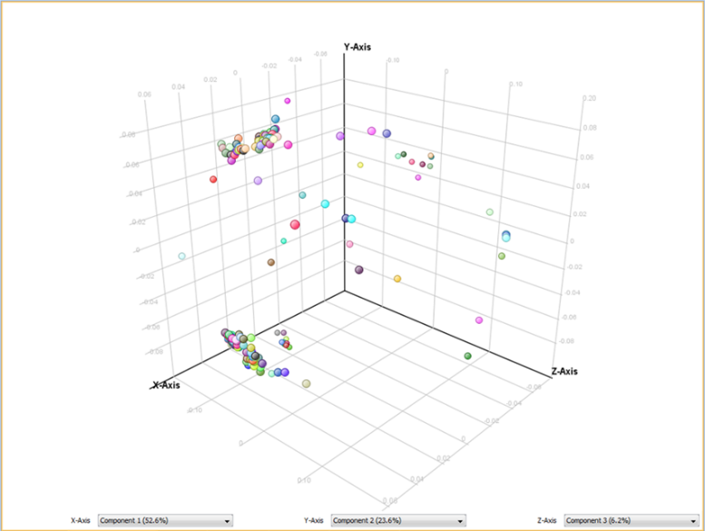
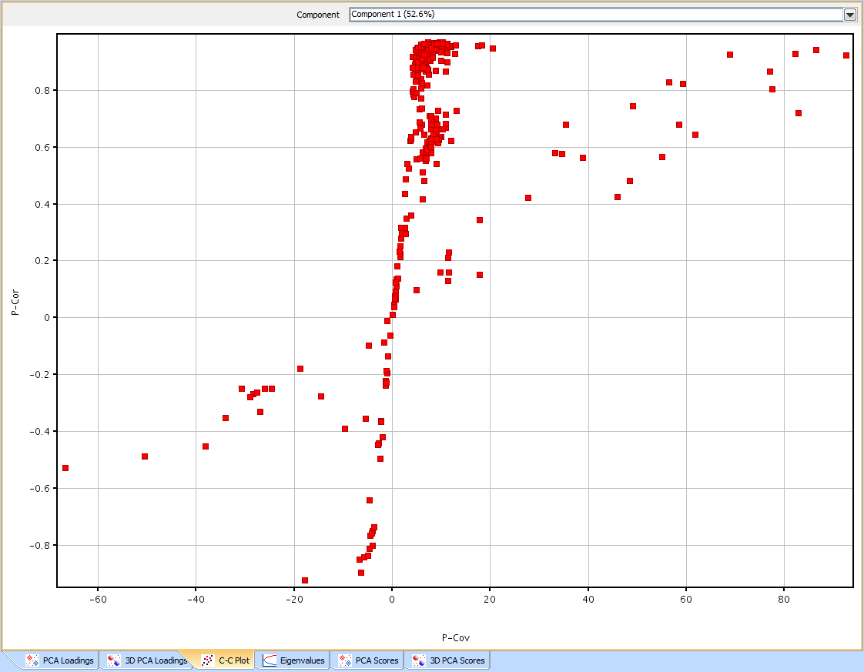
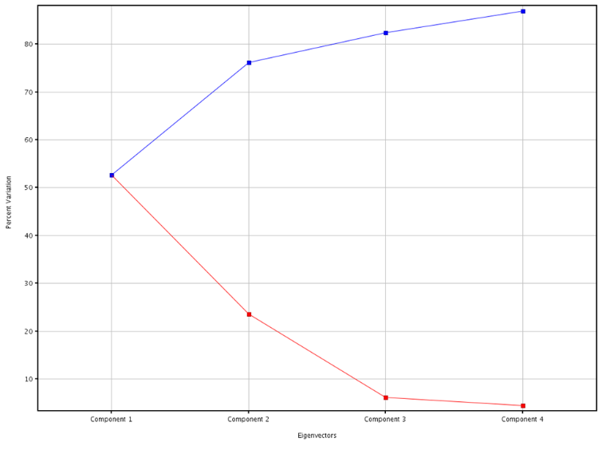
Principle Component Analysis
Reduces complex data sets
First 2 to 3 components should explain most of the variance in the data
Helps identify what features are important
Reliability
Magnitude

Slide 11
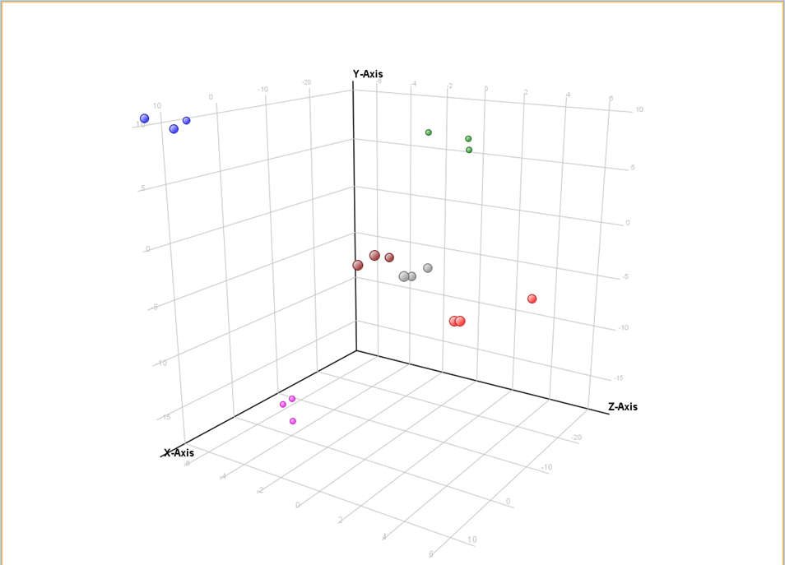
Clustering within conditions 182 features statistically different from baseline at p<0.05 and at least a 2 fold difference in abundance
Baseline
Freeze/Thaw
Delayed Processing
Post-prandial
Delayed Freezing
Standard Feezer (-30C)

Slide 12
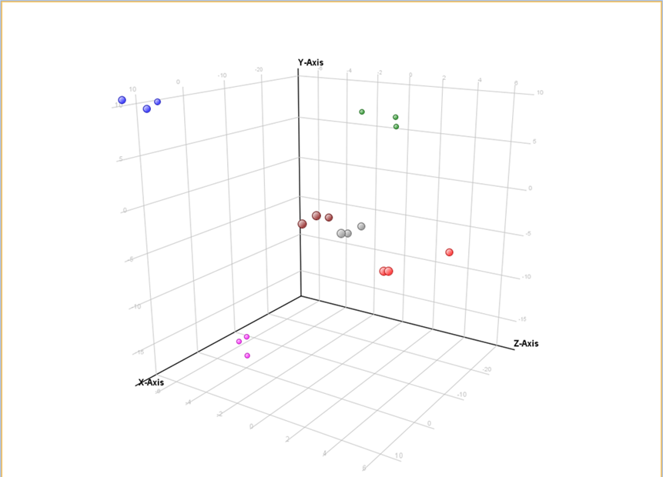
Initial Conclusions
We can generate reproducible data (within condition)
Minor effects
Single freeze/thaw
1 hr RT prior to spinning
Larger impact
8hr delayed freezing
Non-fasting
-30C storage*
Baseline
Freeze/Thaw
Delayed Processing
Post-prandial
Delayed Freezing
Standard Feezer (-30C)

Slide 13
Compound Identification
Bottle neck of the process
Limited by quality of compound databases
High degree of endogenous modification/degradation
Only ~30% of compounds with tentative ID
Current data only Reversed Phase Chromatography
Biased for non-polar lipophilic compounds
ID’s can be ambiguous, multiple isomers

Slide 14
Post-Prandial
50 features decreased > 2 fold relative to baseline (and all others)
Only 11 features increased > 2 fold
10/50 reduced compounds are endocannabinoids
Endocannabinoids
Bind same receptor as THC
Increase with fasting
Hunger/satiety signals
Synthesized “on-demand”
Short half-life

Slide 15
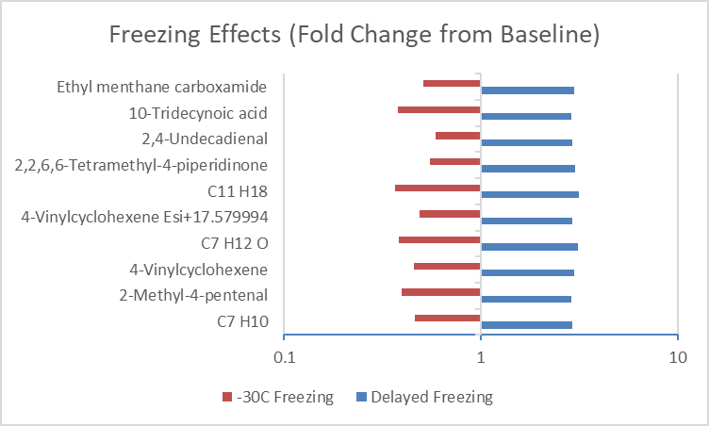
Inverse effects of Delayed freezing and -30C storage
44 compounds increased with delayed freezing and decreased with -30C storage
Kamlage et al. 2014 (Clin Chem 60:2)
11% increased with 16hr 4C plasma storage
Attributed changes to metabolic activity
Pinto et al. 2014 (Analyst 139)
Metabolite reductions with 30 day -20C storage
Attributed to protein precipitation

Slide 16
Conclusions (so far)
The QTOF MS data is reproducible
Preanalytical variables are critical to success
Some more than others
Compound identification is a major challenge
The analyses generate a tonne of data
Garbage in, garbage out
We have a lot still to learn…

